Slide 1

Neural Networks:
An Introduction
Somaiya Machine Learning Research Association (SMLRA)

Slide 2
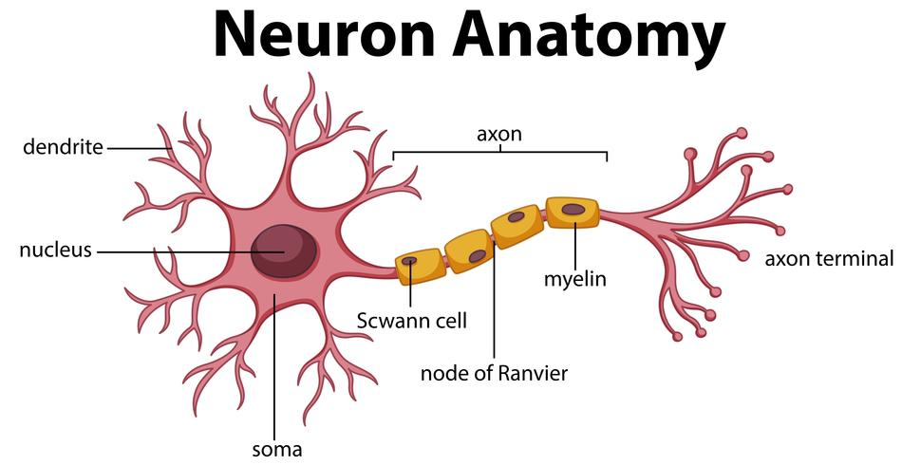
Human Neuron

Slide 3
Neural Network

Slide 4
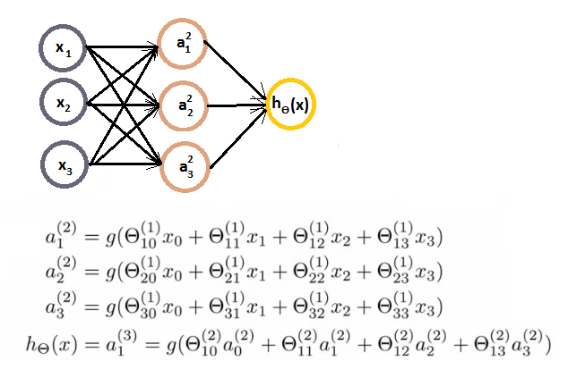
Equations

Slide 5
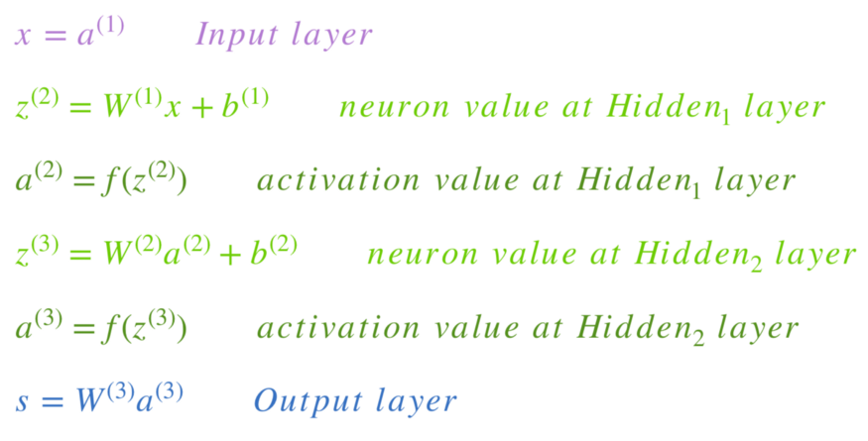

Slide 6
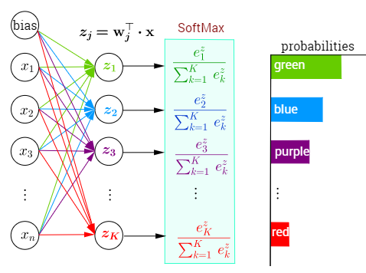

Slide 7
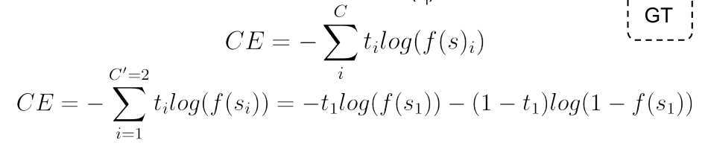
Loss

Slide 8
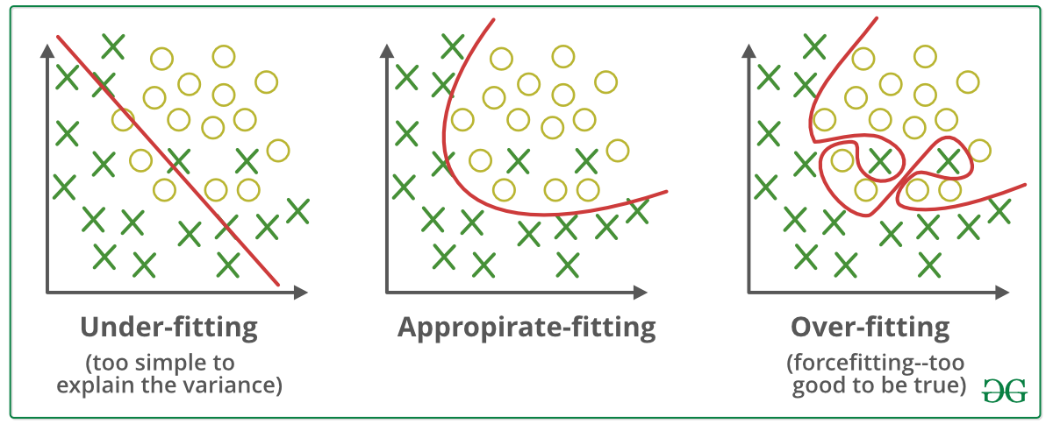
Fitting the Curve

Slide 9
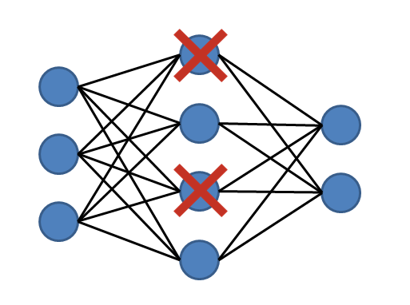
Dropout

Slide 10


Backpropagation

Slide 11
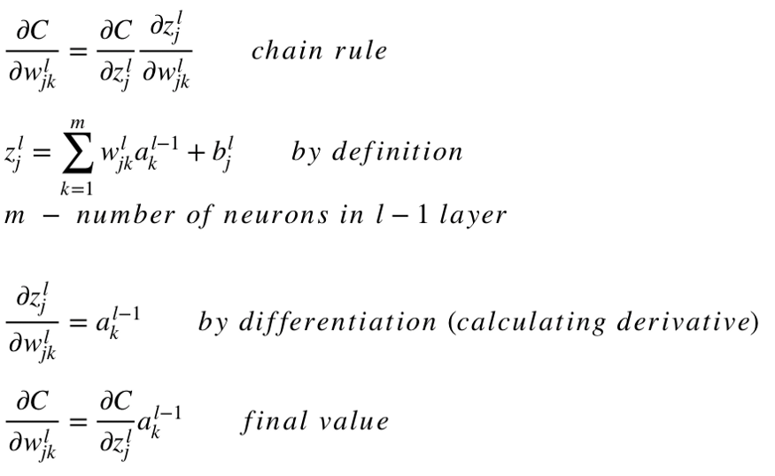

Slide 12

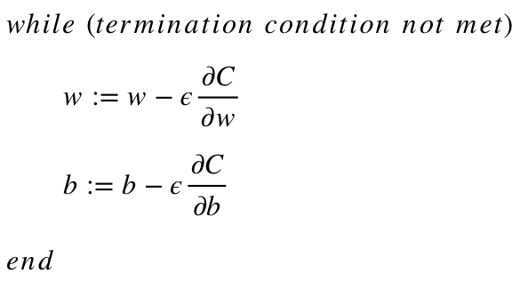

Slide 13
PPTs.stop() ColabNotebooks.load()

